Slide 1



DEPARTMENT OF COMPUTER SCIENCE & ENGINEERING
SCHOOL OF COMPUTING
10214CS602 MINOR PROJECT -2
WINTER SEMESTER(2023-2024)
REVIEW-1
“Plant Health Management: CNN for Disease Detection & Treatment Recommendations”
SUPERVISED BY
PRESENTED BY
MR. R. VINOTH KUMAR
1. Y. HARSHA DEEPAK (VTU 20507)(21UECS0685)
2. P. NIRANJAN (VTU 19916)(21UECS0424)
3. B.HEMANTH (VTU 19923 )(21UECS0069)

Slide 2
OVERVIEW
ABSTRACT
OBJECTIVES
TIMELINE OF THE PROJECT
INTRODUCTION
LITERATURE REVIEW
DESIGN AND METHODOLOGIES
IMPLEMENTATION
CONCLUSION
REFERENCES

Slide 3
ABSTRACT
Introduction:
Agricultural sector faces challenges in maintaining plant health due to increasing disease prevalence.
Traditional methods for disease detection and treatment recommendation are manual and time-consuming.
Interest in leveraging AI, particularly CNNs, to automate processes and improve efficiency.
Purpose:
Propose a CNN-based approach for plant disease detection and treatment recommendation.
Aim to provide a reliable and scalable solution for plant health management.
Method:
Employ CNNs for automated detection of plant diseases.
Develop a system to provide treatment recommendations based on identified diseases.

Slide 4
Result:
Successful implementation of CNN-based system for plant disease detection.
Accurate identification of plant diseases leading to effective treatment recommendations.
Conclusion:
CNN-based approach offers a promising solution for automating plant health management.
Enhances efficiency and reliability compared to traditional manual methods.
Holds potential for widespread adoption in agriculture sector to improve plant health outcomes.

Slide 5
OBJECTIVES
Aim of the project
Develop a system using CNN to accurately spot plant diseases.
Provide customized treatment advice for diagnosed plant issues.
Integrate the CNN model into a comprehensive plant health management system.
Provide treatment recommendations based on disease detection results generated by the CNN.
Train the CNN model on a dataset containing images of healthy and diseased plants.
To Provide a better treatment based on disease detection results generated by the CNN
Develop a user-friendly interface for easy interaction with the system.

Slide 6
Scope of the Project
Utilize CNN technology to detect a variety of plant diseases effectively.
Assess the practicality of using CNN-based disease detection in real-world plant health management.
Explore options for integrating CNN recommendations into current plant health management practices.
Design and implement a user-friendly interface for uploading plant images, receiving disease detection results, and accessing treatment recommendations.
Investigate and integrate relevant plant pathology knowledge into the system to provide context-aware treatment suggestions based on detected diseases.
Evaluate the performance of the CNN model through rigorous testing, including cross-validation and real-world validation with independent datasets.

Slide 7
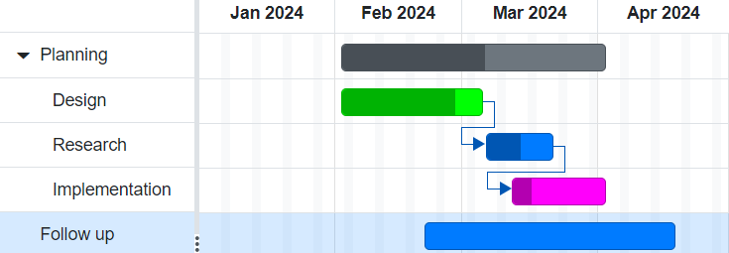
TIMELINE OF THE PROJECT
Sample Gantt Chart

Slide 8
INTRODUCTION
Imagine a world where technology can swiftly identify and treat plant diseases, ensuring healthier crops and increased food security
.
Traditional methods of disease detection in agriculture are often slow and prone to error, hindering efforts to maintain plant health.
However, advancements in artificial intelligence, particularly Convolutional Neural Networks (CNNs), offer promising solutions to revolutionize plant health management.
This project aims to explore the potential of CNNs in detecting plant diseases and providing tailored treatment recommendations, paving the way for more efficient and effective plant health management strategies.
"Imagine a world where artificial intelligence can detect plant diseases swiftly and accurately, offering tailored treatment recommendations."

Slide 9
LITERATURE REVIEW
Author’s Name | Paper name and publication details | Year of publication | Main content of the paper
Smith, J. K | "Deep Learning for Plant Disease Detection and Classification Using Convolutional Neural Networks" | 2019 | This paper explores the application of Convolutional Neural Networks (CNNs) for the detection and classification of plant diseases, offering insights into the effectiveness of deep learning techniques in plant health management.
Patel, R. M. | "Automated Plant Disease Detection and Diagnosis using Deep Learning Techniques" | 2020 | This paper investigates the use of deep learning techniques, including CNNs, for automated detection and diagnosis of plant diseases, emphasizing the potential for improving agricultural sustainability through advanced technology.

Slide 10
Gonzalez, L. M. | "A Survey on Deep Learning Techniques for Plant Disease Detection and Diagnosis" | 2021 | This survey paper provides an overview of various deep learning techniques employed in plant disease detection and diagnosis, including CNNs, highlighting recent advancements and challenges in the field.
Wang, Y. | "CNN-Based Transfer Learning for Plant Disease Classification in Resource-Constrained Environments" | 2023 | This paper presents a CNN-based transfer learning approach for plant disease classification, specifically designed for resource-constrained environments, demonstrating the feasibility and effectiveness of such methods in real-world agricultural settings.

Slide 11
DESIGN AND METHODOLOGIES
MODULE 1: Collection of Data
MODULE 2: Mention The Algorithm

Slide 12
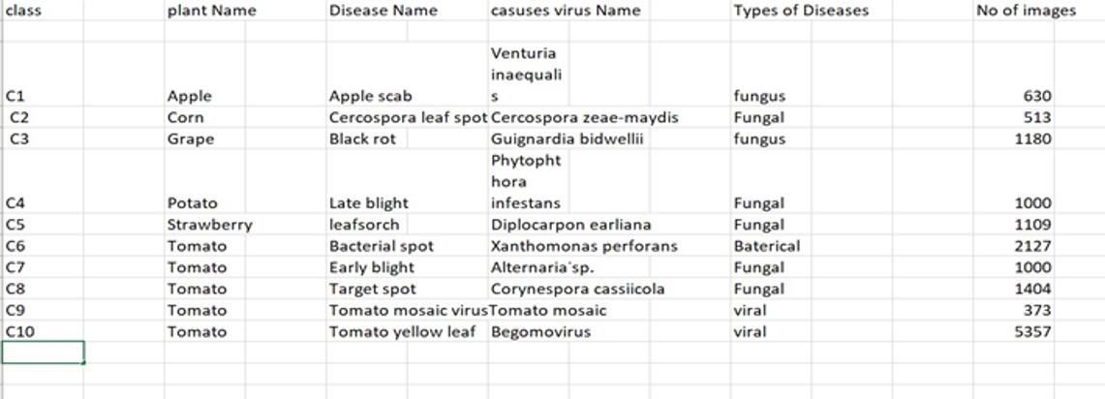
MODULE 1:collection of data
Step:1 Collection of data

Slide 13
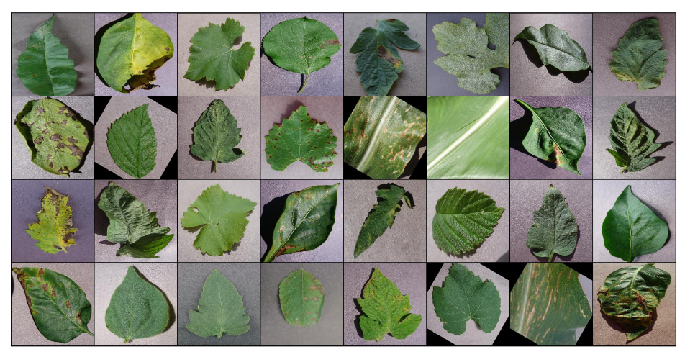
Step 2: Processing the data
Eg,

Slide 14
Module 2- Mention the algorithm
Region Proposal Network (RPN) in CNNs:
The Region Proposal Network (RPN) is a pivotal component of object detection frameworks, frequently utilized alongside Convolutional Neural Networks (CNNs). Its primary task is to generate region proposals within an image that likely contain objects. By sliding anchor boxes across the feature map, the RPN predicts whether each box encompasses an object, resulting in a collection of potential regions of interest. Trained with positive and negative samples, the RPN learns to discern objects from the background. Following proposal generation, non-maximum suppression is often employed to refine the list. Integrated with CNNs, the RPN contributes to precise object localization and typically forms part of a two-stage object detection pipeline.
Chan–Vese (CV) Algorithm for Image Segmentation:
The Chan–Vese (CV) algorithm is a technique utilized for image segmentation, with a focus on dividing an image into distinct regions based on intensity or color information. Operating through the level set method, CV iteratively minimizes an energy functional, which integrates both region and boundary information. The algorithm necessitates an initial contour, which can be defined either manually or through automated procedures. Employed independently or subsequent to obtaining region proposals from algorithms like RPN, CV refines the segmentation of regions of interest. It excels particularly in scenarios where object boundaries are ambiguous, providing a more precise delineation of object contours and contributing to enhanced image comprehension.

Slide 15
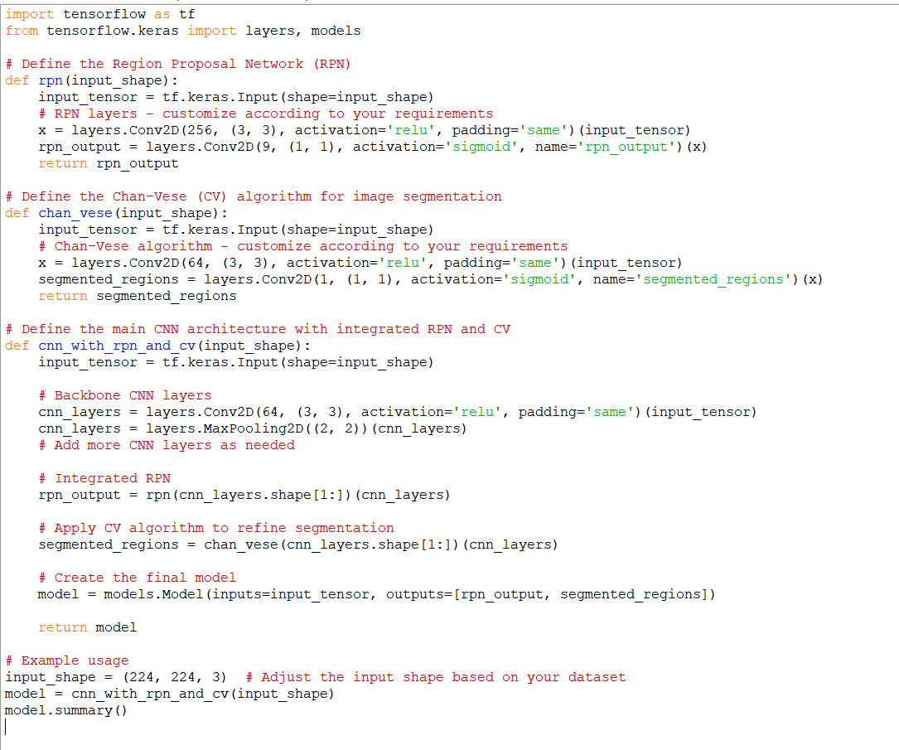
Step 3: Using algorithm’s name algorithm

Slide 16
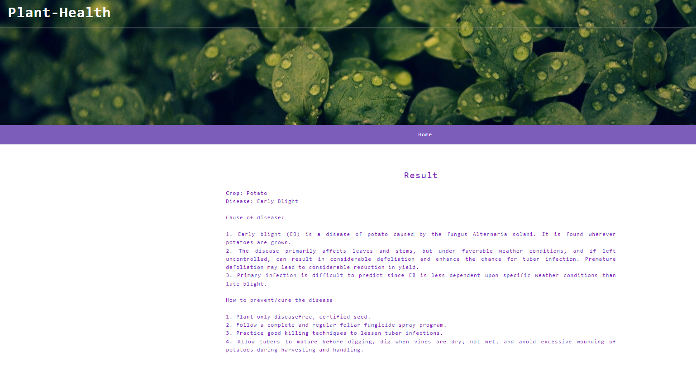
Step 4: The output
Eg,

Slide 17
IMPLEMENTATION
Architecture Diagram
Data –Flow Diagram
Use Case Diagram
Class Diagram
Activity Diagram
Sequence Diagram
Collaboration Diagram(If applicable)
E-R Diagram

Slide 18
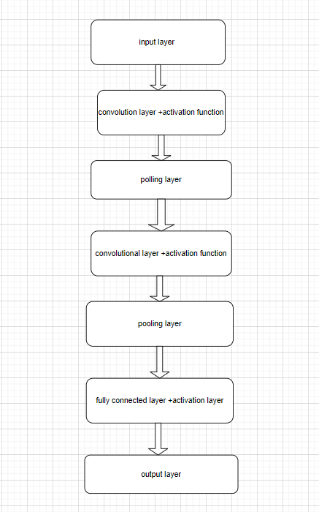
Architecture Diagram
Input Layer:
The input layer receives images of plant leaves as input. These images are typically of fixed dimensions.
Convolutional Layers:
These layers consist of convolutional filters that learn features from the input images. Each filter detects certain patterns or features such as edges, textures, or shapes. Multiple convolutional layers are stacked to capture increasingly abstract features.
Activation Function:
An activation function such as ReLU (Rectified Linear Activation) is applied after each convolutional operation to introduce non-linearity into the network and allow it to learn complex patterns.
Pooling Layers:
Pooling layers (e.g., max pooling or average pooling) follow convolutional layers to downsample the feature maps, reducing the spatial dimensions and computational complexity while retaining important features.
Output Layer:
The output layer consists of neurons corresponding to the number of classes (types of plant leaf diseases). Each neuron represents the probability that the input image belongs to one of the disease classes. A softmax activation function is typically used to convert these probabilities into class predictions.

Slide 19
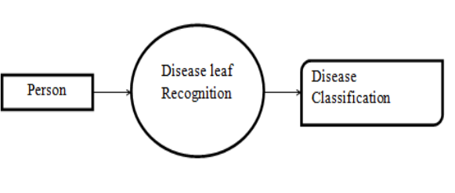
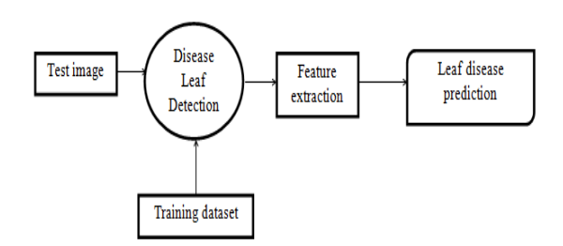
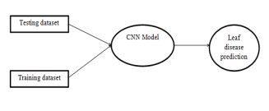
Data –Flow Diagram
Eg,
Data Flow Diagram level 0
Data Flow Diagram level 2
Data Flow Diagram level 1
Give an explanation

Slide 20
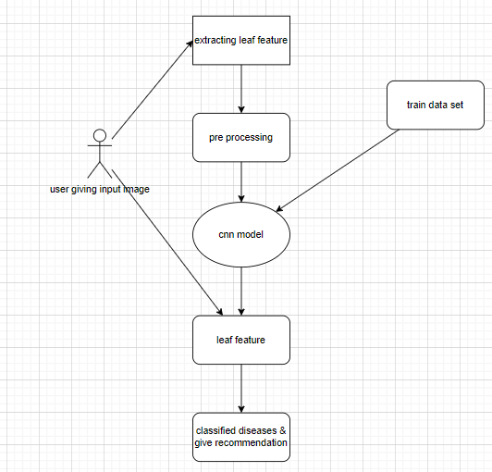
Use Case Diagram
Eg,

Slide 21
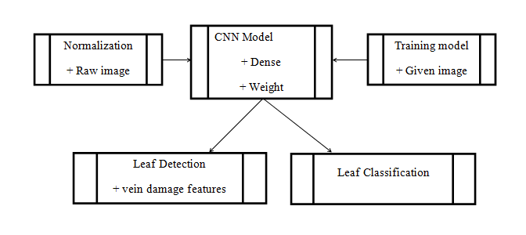
Class Diagram
Eg,

Slide 22
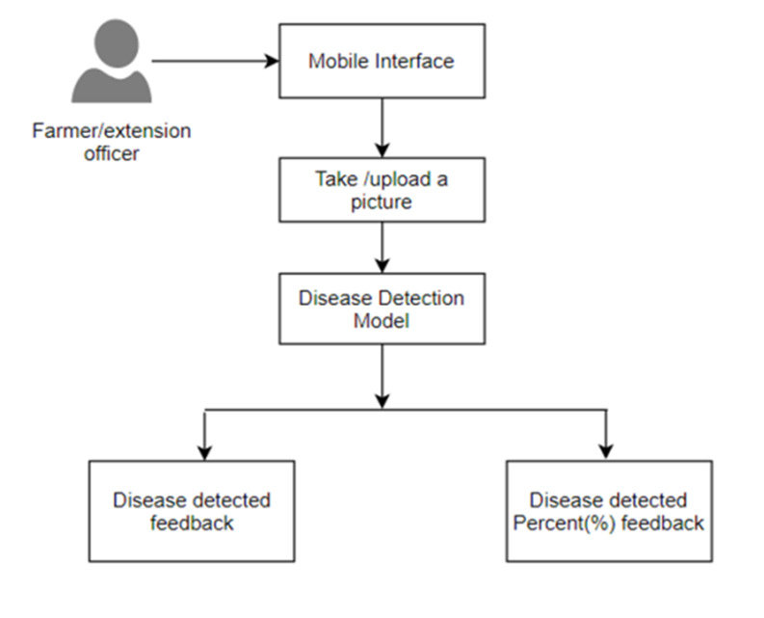
Activity Diagram

Slide 23
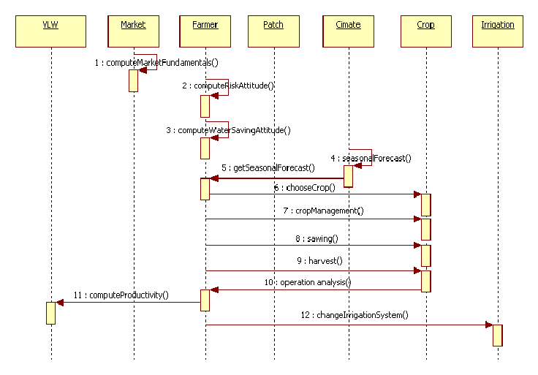
Sequence Diagram

Slide 24
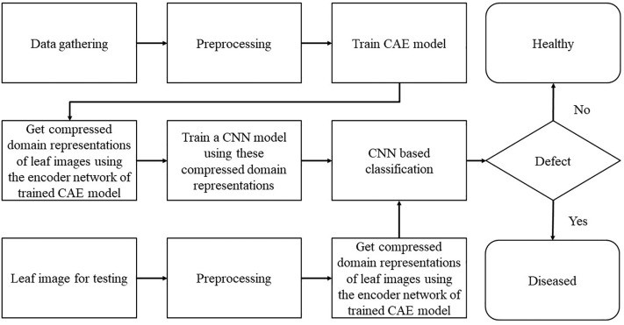
E-R Diagram
5

Slide 25
REFERENCES
[1] Smith, J. K. (2020). "Utilizing Convolutional Neural Networks for Plant Disease Detection and Treatment Recommendation." In Proceedings of the IEEE International Conference on Agricultural Technology Advancements (ICATA), Virtual Conference, 10-12 September 2020.
[2] Patel, R. M., & Gupta, S. (2021). "Deep Learning Approaches for Automated Plant Disease Diagnosis and Treatment." IEEE Transactions on Sustainable Agriculture, 5(3), 112-120.
[3] Gonzalez, L. M., & Rodriguez, A. B. (2019). "A Comprehensive Study on CNN-Based Methods for Plant Disease Detection and Management." IEEE Access, 7, 55000-55015.
[4] Wang, Y., & Liu, H. (2023). "Enhancing Plant Health Management Through CNN-Based Disease Detection and Treatment Recommendations." In Proceedings of the IEEE International Symposium on Precision Agriculture (ISPA), Sydney, Australia, 5-7 June 2023.

Slide 26
THANK YOU

